Slide 1

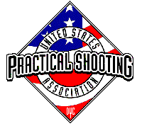
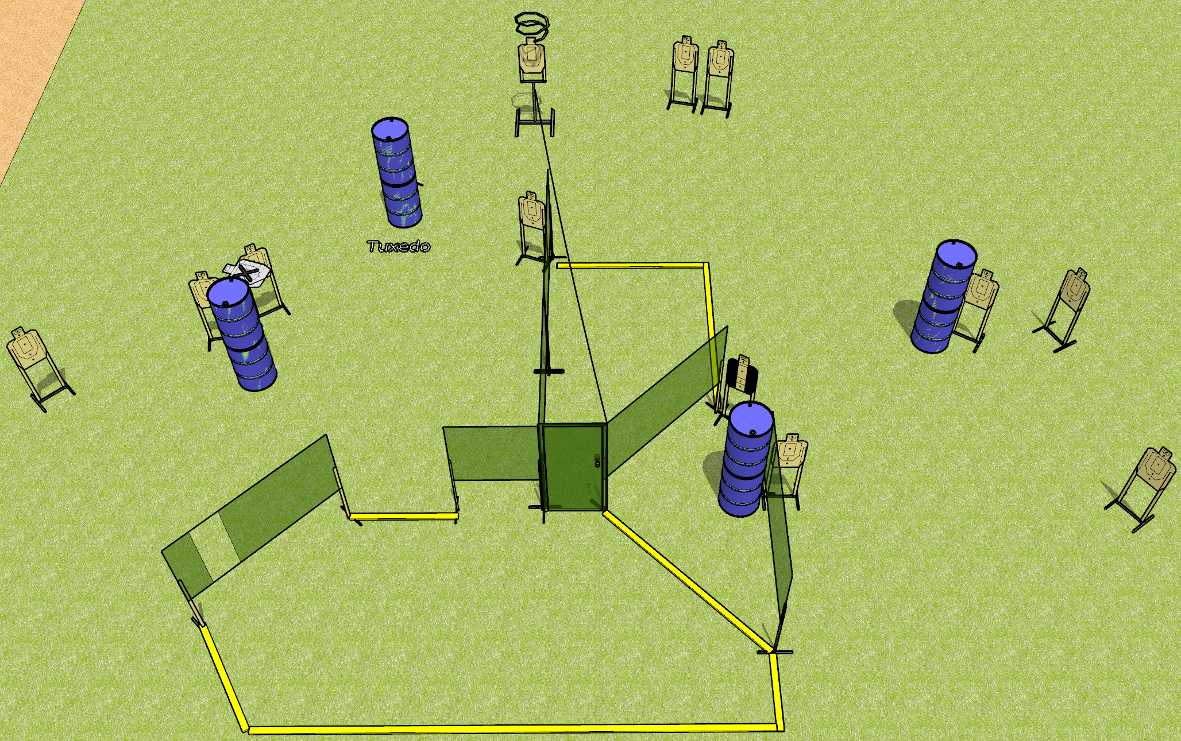
 | Dothan Gun Club – USPSA Match Knock Knock Course Designer : Drew Coleman
Round Count 26 rounds 13 USPSA targets
Equipment List 10 wall feet Door Drop turner 2 tuxedos

Slide 2
Knock Knock
Written Stage Briefing
Knock Knock is a 26 round, 130 point, Comstock field course. There are 13 USPSA targets. The best 2 hits on paper will score. The start signal is audible.
The drop turner is activated by opening the door and is a disappearing target. Please check the activator prior to walkthrough and set it the same way every time.
Handgun start position is both hands touching door. Handgun is unloaded and holstered.
PCC start position is muzzle touching door, unloaded.
On start signal, engage targets from within the shooting area.

